Slide 1
SBOM Overview
CET WW19 + CSLP Sync WW22 + MTL/ARL PSXT WW24 + CPE TRB WW32
Peter Tiegs CCG/CPE/C4S DevOps PE
Notes:
Topic: SBOM gap analysis and plan for engagement w/ customers
Presenter: Madhu Datla, Chris Shorey, Dinyar Dastoor

Slide 2
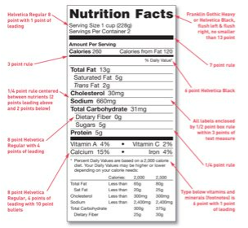
SBOM Background
SBOM is a machine-readable data format that is required for selling software to the US government(Executive Order 14028) that describes the software components bill of materials aka software supply chain that go into our software products
Memorandum M-22-18 sets specific timelines for government agencies to require SBOM from vendors
SPDX is an ISO standard (ISO/IEC 5962:20) for delivering SBOM information, but other formats are available
Notes:
SBOM Overview
What is SBOM
Who is this applicable too?
Alignment w/ 1BOM (PTL & Beyond)
What does it mean for ADO (CPE) Dev Teams, CCG BKC

Slide 3
Acceptable SBOM Attributes
NTIA recommended minimum SBOM attributes
DATA FIELD | DESCRIPTION
Supplier Name | Name of the entity that creates, defines, and identifies components
Component Name | Designation assigned to a unit of software defined by the original supplier
Version of the Component | Identifier used by the supplier to specify a change in software from a previously defined version
Other Unique Identifiers | Other identifiers that are used to identify a component, or serve as a look-up key for relevant database
Dependency Relationship | Characterizing the relationship that an upstream component X is included in software Y
Author of SBOM Data | The name of the entity that creates the SBOM data for this component
Timestamp | Record of the date and time of the SBOM data assembly

Slide 4



Which products need SBOM?
Decision flow for SBOM requirement
Distribution
Type
Requirement
Patch release
SBOM required
Major/Minor release
External to Intel
EAR/Beta release
Open Source
Only for Internal Use
SBOM optional

Slide 5
Customer Discussions
Department of Defense
Dell
Met with CCE and C4S
Lots of commonality uses SPDX based on BDBA
HP
Early discussion with CCE
Microsoft
Exploring how they will use SBOM in HW Dev Center/WHQL
OEM SBOM
OEM Machines
Windows
SBOM
3rd party & Open source SBOM
Intel SW Kit SBOM
Intel FW SBOM(s)
3rd party & Open source SBOM
Intel Driver SBOM(s)
3rd party & Open source SBOM
Intel App SBOM(s)
3rd party & Open source SBOM
Intel SW Tool SBOM(s)
3rd party & Open source SBOM

Slide 6
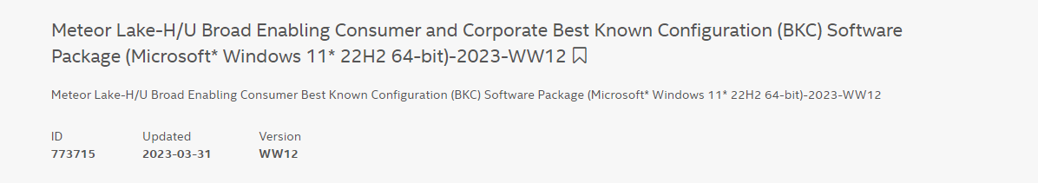
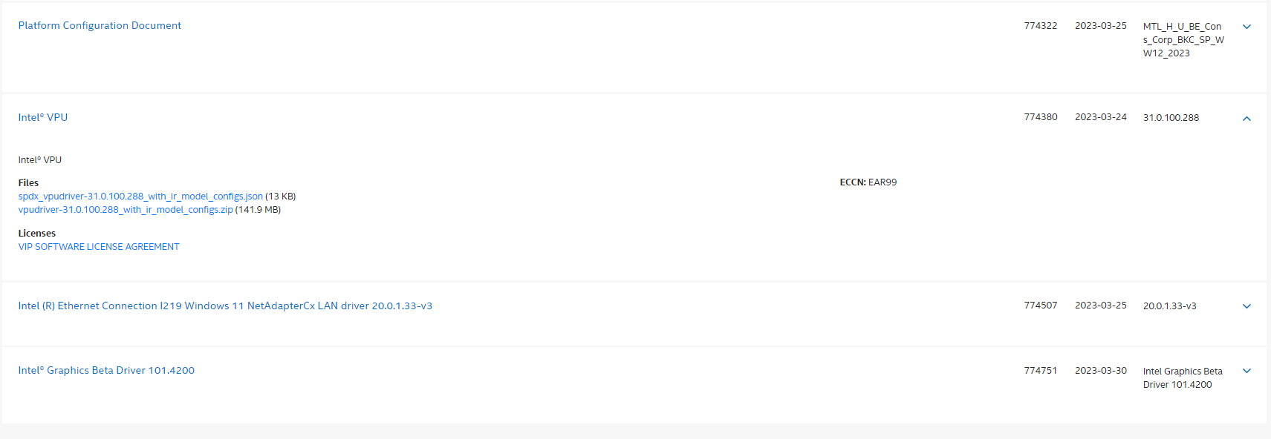
Microsoft-Intel Confidential

Slide 7
Creation Information
"spdxVersion": "SPDX-2.2",
"documentNamespace": "https://intel.com/spdxdocs/RPL-P-BKC-SPDXRef-Document",
"creationInfo": {
"creators": [
"Organization: Intel Corporation (support@intel.com)"
],
"created": "2022-12-08T21:29:48Z",
"licenseListVersion": "3.6"
},
"dataLicense": "CC0-1.0",
"SPDXID": "SPDXRef-Document",
"name": "Raptor Lake-P/H DDR5/DDR4 Consumer Production Version(PV) Best Known Configuration(BKC) Software Package (Microsoft Windows 11 22H2\u2013 64 bit ) WW46-2022",
Author(s) of SBOM
Creation Time Stamp
Direct Text from RDC
Microsoft-Intel Confidential

Slide 8
Single Ingredient Package
Generated ID for this Package
"SPDXID": "SPDXRef-package-0af2a6ef-a821-4e24-b448-de3dd465b52d",
"name": "Intel\u00ae Graphics Production Version Driver 101.3688",
"downloadLocation": "https://cdrdv2.intel.com/v1/dl/getContent/751214/751057?win64.zip",
"licenseConcluded": "NOASSERTION",
"licenseInfoFromFiles": ["NOASSERTION"],
"licenseDeclared": "NOASSERTION",
"copyrightText": "Intel Corporation, 2022",
"versionInfo": "Intel Graphics Production Version Driver 101.3688",
"packageFileName": “win64.zip",
"supplier": "Organization: Intel Corporation (support@intel.com)",
"externalRefs": [
{
"referenceCategory": "OTHER",
"referenceType": “IntelContentID",
"referenceLocator": "751057",
"comment": "Intel Design Center Content"
}
],
Component Name for this package from RDC
Download Location for this package
Component Version for this package
Supplier Name for this package
External Reference to RDC
Microsoft-Intel Confidential

Slide 9
Package File Data
"files": [
{
"File": {
"name": "win64.zip",
"SPDXID": "SPDXRef-file-14fd6bc5-d0e1-4232-a075-6dda1b5c0eaf",
"checksums": [
{
"algorithm": "checksumAlgorithm_sha1",
"checksumValue": "D20B73732BCC2FDD9557173285A20920F518CE7E"
},
{
"algorithm": "checksumAlgorithm_sha256",
"checksumValue": "abd3458f88aa09c7e4382d68a88a9e5a45168b8fffe4bc3ba4120fdecfa6a24e"
}
],
"licenseConcluded": "NOASSERTION",
"licenseInfoFromFiles": ["NOASSERTION"],
"copyrightText": "Intel Corporation, 2023"
}
}
]
Autogenerated File ID for this Document
Checksums for this File
Microsoft-Intel Confidential

Slide 10
TPV data from Black Duck
Generated ID for this Document
"Package": {
"SPDXID": "SPDXRef-package-356fe6ea-b80c-4fb1-a91c-76204fb30511",
"name": "zlib",
"downloadLocation": "NOASSERTION",
"packageVerificationCode": {
"packageVerificationCodeValue": null
},
"licenseConcluded": "Zlib",
"licenseInfoFromFiles": [
"NOASSERTION"
],
"licenseDeclared": "NOASSERTION",
"copyrightText": "NOASSERTION",
"versionInfo": "1.2.11",
"homepage": "https://zlib.net/",
"externalRefs": [
{
"referenceCategory": "PACKAGE_MANAGER",
"referenceType": "purl",
"referenceLocator": "pkg:generic/zlib@1.2.11",
"comment": "{\"tool\": \"Synopsys BDBA\", \"value\": {\"name\":\"zlib\", \"version\": \"1.2.11\", \"codetype\": \"native\"}}"}
],
"files": []
}
Component Name from Synopsys BDBA
Component Version from Synopsys BDBA
Homepage for this Kit from Synopsis BDBA
Third Party MetaData
Microsoft-Intel Confidential

Slide 11

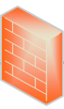
Platform SW Release to OEM Process
Release: Internal to Intel
Release: External to Intel
Intel – Differentiated Ingredients
OS + Industry Standard IP & Insource Drivers
OneKit
OEM/ODM/Partners
OneBKC
HSD-ES
GFX
LAN
Salesforce
IDF One Trunk Continuous Delivery
CCG
GFX
USB
LAN
AUDIO
Unified Source
WWAN
RST
…
Delivery to
Customers
Binary Scan (BDBA)
WWAN
AUDIO
DCAI
UAM
RDC & Download Center
NEX
Synaptica, EPM
RST
…
SATG
Platform Integration &Validation
SBOM Generation
Other Software
Delivery to Customers
Add SBOM Generation to OneKit
Notes:
Interim Solution:
SPDX file format
Alternatives: MSFT Tool, BDBA based, Python Libraries etc (backup)
1Kit features to create SPDX files
Feedback from Dell

Slide 12


High Level Flow SBOM SPDX Generation
Create a Kit
Add Packages to Kit
Create Kit SBOM
Add SBOM Document to Kit
Publish Kit
BKC
Create Packages
Add Files to Package
Scan Package Files
Create Package SBOM
Add SBOM Document to Package
Publish Packages
SBOM Generation Combines Intel Kits with BDBA Data
Generates SPDX using the SPDX.org Python-Tools 0.6*
Intel IPU JSON uses SPDX Nodes
Notes:
0.6 with one feature backported from 0.7 which just had the first release today

